Slide 1
Magnetic Field

Slide 2

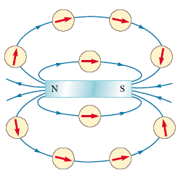
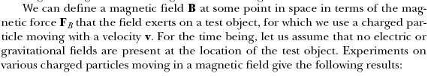
An electric field surrounds any stationary or moving electric charge.
In addition to an electric field, the region of space surrounding any moving electric charge also contains a magnetic field.
A magnetic field also surrounds any magnetic substance.
The symbol B has been used to represent a magnetic field.

Slide 3

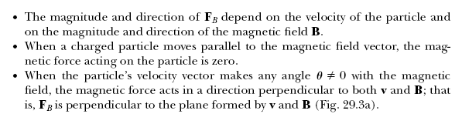
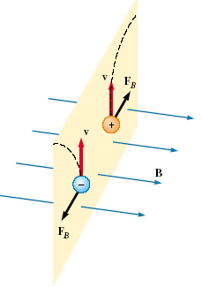
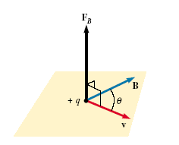

Slide 4
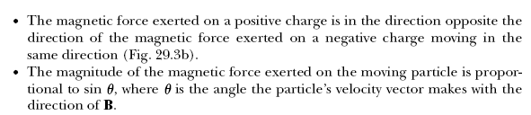

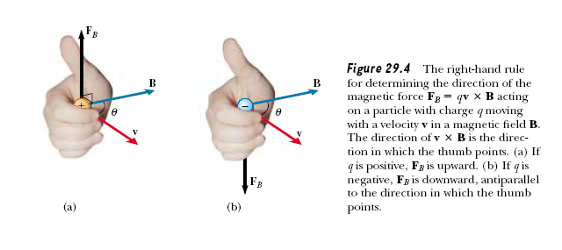

Slide 5



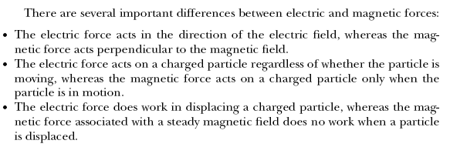

Slide 6


http://fys.kuleuven.be/pradem/applets/suren/MovChgMag/MovChgMag.html

Slide 7

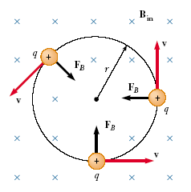
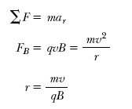


A positively charged particle moving in a uniform magnetic field with the initial velocity vector of the particle perpendicular to the field. Let us assume
that the direction of the magnetic field is into the page. Figure shows that the particle moves in a circle in a plane perpendicular to the magnetic field. The particle moves in this way because the magnetic force FB is at right angles to v and B and has a constant magnitude qvB. As the force deflects the particle, the directions of v and FB change continuously, as Figure shows. Because FB always points toward the center of the circle, it changes only the direction of v and not its magnitude.
If q were negative, the rotation would be clockwise.
These results show that the angular speed of the particle and the period of the circular motion do not depend on the linear speed of the particle or on the radius of the orbit. The angular speed is often referred to as the cyclotron frequency because charged particles circulate at this angular speed in the type of accelerator called a cyclotron,

Slide 8



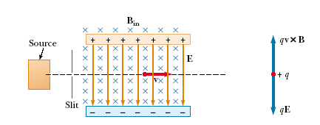


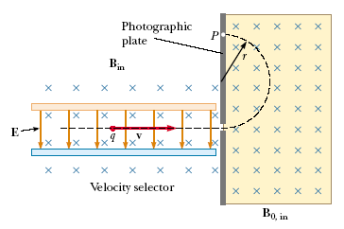



A variation of this technique was used by J. J. Thomson
(1856–1940) in 1897 to measure the ratio e/me for electrons.

Slide 9


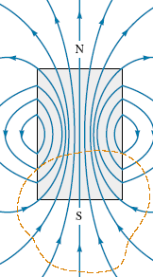
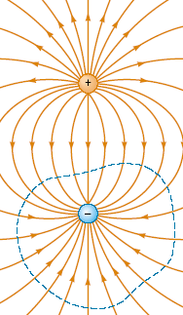
An isolated magnetic poles (monopoles) have never been detected and perhaps do not exist.
The magnetic field
lines of a bar magnet form closed
loops. Note that the net magnetic
flux through the closed surface
(dashed red line) surrounding one
of the poles (or any other closed
surface) is zero.
The electric field lines surrounding an electric dipole begin on the positive charge and terminate on the negative
charge. The electric flux through a
closed surface surrounding one of
the charges is not zero.

Slide 10
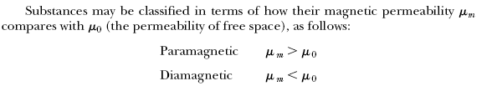

Substances can be classified as belonging to one of three categories, depending on
their magnetic properties. Paramagnetic and ferromagnetic materials are those
made of atoms that have permanent magnetic moments. Diamagnetic materials
are those made of atoms that do not have permanent magnetic moments.

Slide 11
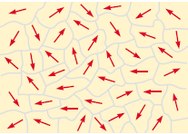
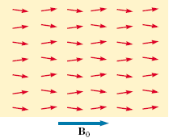
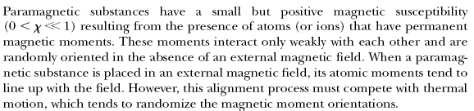
A small number of crystalline substances in which the atoms have permanent magnetic moments exhibit strong magnetic effects called ferromagnetism.
Some examples of ferromagnetic substances are iron, cobalt, nickel, gadolinium, and dysprosium.
All ferromagnetic materials are made up of microscopic regions called domains, regions within which all magnetic moments are aligned. These domains have volumes of about 10^12 to 108 m3 and contain 10^17 to 10^21 atoms. The
boundaries between the various domains having different orientations are called domain walls.

Slide 12

